Slide 1
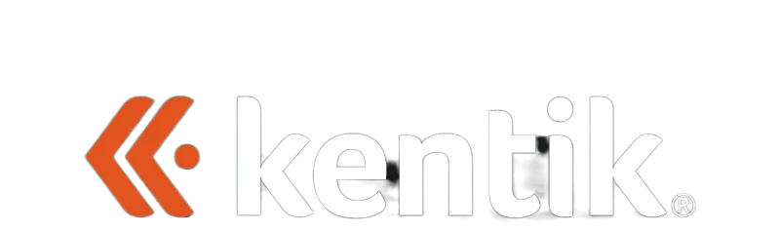
The ROI of Network Autonomy
Building the Business Case for Agentic Tool-Chaining

Slide 2
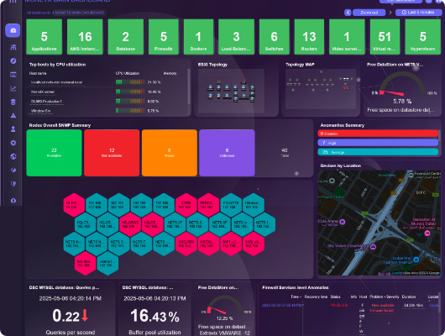
The Successful Failure
THE NARRATIVE SUMMARY
Two years ago, Justin’s Dog Emporium¹ set out to build the holy grail: a "Self-Healing Network."
The technical team successfully chained a high-fidelity observability platform to an automation engine via API "middleware."
Technically, it was a triumph. Mitigation happened in seconds.
Fiction based on a true story

Slide 3
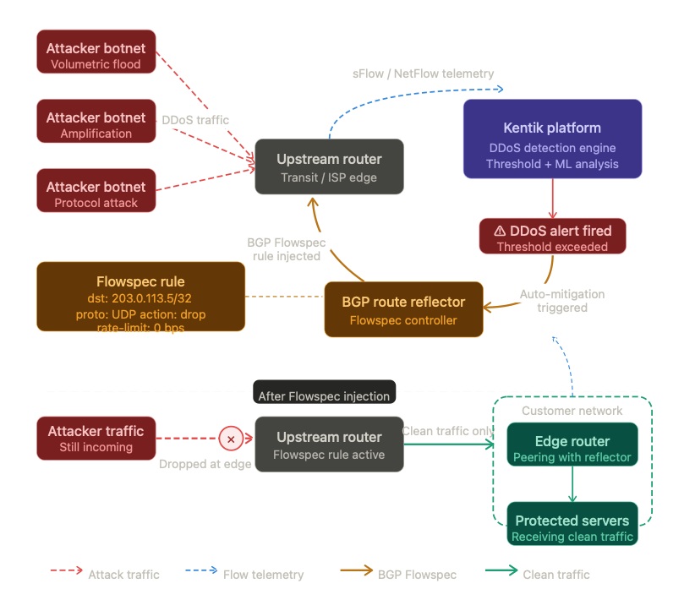
Technical Win: DDOS Mitigation
CLOSED-LOOP API CHAIN
They automated BGP Flowspec route injection directly from real-time telemetry events.
20-second detection-to-remediation
Automated Flowspec injection
Zero human intervention required
</>

Slide 4
The Architecture
THREE-LAYER SOLUTION
LAYER 1: OBSERVE
Collects flow data, metrics, and anomaly signals in real time via Netflow and SNMP
LAYER 2: DECIDE
Middleware receives alert and decides whether to send BGP Flowspec — the “brain” of the chain
LAYER 3: ACT
BGP Flowspec injection mitigates attack traffic while leaving legitimate traffic in tact
➔
➔
The “middleware” layer is what transforms a collection of tools into an intelligent chain — it is the highest-leverage engineering investment in the autonomy stack.
<1min
100%
auditable — every action is logged with full context
from detection to mitigation

Slide 5
Compressing MTTR: Minutes to Seconds
Automated mitigation deployed
Manual response time (minutes)
Autonomous (seconds)
By removing human latency, the organization achieves instantaneous resilience.

Slide 6
The Boardroom “NO”
100%
0%
Technical Success
Executive Funding
Executives didn't see a breakthrough; they saw a "Black Box" risk. Who was responsible if the automation mitigated legitimate traffic? The project was nearly shelved.

Slide 7
Lessons Learned: Data is Trust
OBSERVE
Observability is not just for troubleshooting; it is the evidence for autonomy.
PROTECT
Moved from "Self-Healing" buzzwords to "Observability-Led Protection."
MEASURE
Stop reporting packets; start reporting "Productivity Hours Retained."

Slide 8
Building the Business Case
FROM TECHNICAL PROOF-OF-CONCEPT TO FUNDED PROGRAM
01 Map the Pain
Document every manual incident response step. Capture engineer hours, escalation paths, and customer-impact windows. This is your baseline cost.
02 Translate to Money
Convert time to dollars. Use fully-loaded engineer cost, SLA penalties, and revenue-per-minute uptime figures. Finance needs a number, not a percentage.
03 Run a Controlled Pilot
Automate one narrow use case in a non-production environment first. Generate data. The pilot is your evidence, not your product.
04 Present the Narrative
Tell a story with before/after metrics. Lead with business drivers, not cool technology. Give executives a clear owner and an audit trail for every automated action.
Key insight: Executives fund outcomes, not architectures. Frame every slide around productivity hours retained and revenue protected.

Slide 9

"Trust is built through transparency. If the execs cannot see the evidence behind an autonomous decision, they will never fund the solution."
— The 2026 Leadership Mandate

Slide 10
Quantifying the ROI
Impact Metric | Manual Mitigation | Automatic Mitigation | Benefit
Avg. Response Time | 42 Minutes | 38 Seconds | -98.5%
Downtime Cost / Event | $65,000 | $800 | $64k saved
Engineer Involvement | 3 Senior Staff | 1 Junior Staff | 95% reallocation
(Saved Productivity + Risk Avoidance)
ROI=
Tool chaining Cost

Slide 11
Addressing the “Black Box”
FROM TECHNICAL PROOF-OF-CONCEPT TO FUNDED PROGRAM
EXECUTIVE CONCERN
WITHOUT GUARDRAILS
OUR SAFEGUARD
“What if it blocks legitimate traffic?”
Unconstrained automation with no audit trail
Confidence threshold + human approval gate
“Who is accountable when it fails?”
Unclear ownership, no rollback procedure
Named runbook owner + automated rollback within 60 seconds
“Can we trust the observability data?”
Single data source, no cross-validation
Dual-source telemetry validation before any automated action fires
Every concern the board raises is an opportunity to demonstrate engineering rigor — not a reason to abandon the project.

Slide 12
The "Digital Intern" Concept
Digital lntern – Network Automation
Attack signal detected
BUILDING CULTURAL TRUST
They pivoted their messaging. Instead of an all-powerful "Self-Healing Network," they presented the tool-chain as a Digital Intern.
The intern performs the manual toil (collecting data, injecting routes) but requires human-in-the-loop sign-off for high-risk production changes.
This transparency secured the funding.
Data collection
Traffic, logs, BGP state
Route injection prep
Build blackhole/divert routes
Threat analysis
Scope, impact, recommendation
Proposed change package
Routes, rationale, impact summary
Human sign-off (all changes)
Engineer reviews and approves
Mitigation deployed to production
Human touchpoints
Intern (manual toll)
Change package
Production

Slide 13
Roadmap To Autonomy
PHASE 1
OBSERVE
BGP Flowspec to Device
PHASE 2
CHAIN
API Alert + BGP Flowspec
PHASE 3
AGENTIZE
AI Guided Human Decision
PHASE 4
AUTONOMY
Agentic Action
"Move at the speed of software, but with the safety of a network engineer."

Slide 14
Is Your Team Ready for Autonomy?
THE SOCIOTECHNICAL READINESS CHECKLIST
TECHNICAL READINESS
ORGANIZATIONAL READINESS
✓ | High-fidelity telemetry in place
✓ | Documented API calls for each tool
✓ | Event-driven middleware or orchestration layer
✓ | Rollback mechanism tested in staging
✓ | Immutable audit log for every action taken
✓ | Executive sponsor identified and briefed
✓ | Team trained on “human-in-the-loop” escalation policy
✓ | Change management runbook approved by ops and security
✓ | Success metrics agreed upon before go-live
✓ | Quarterly review cadence with leadership established
Rule of thumb: If you cannot answer “what happens when it goes wrong?” in under 30 seconds, your org is not yet ready for production autonomy.

Slide 15
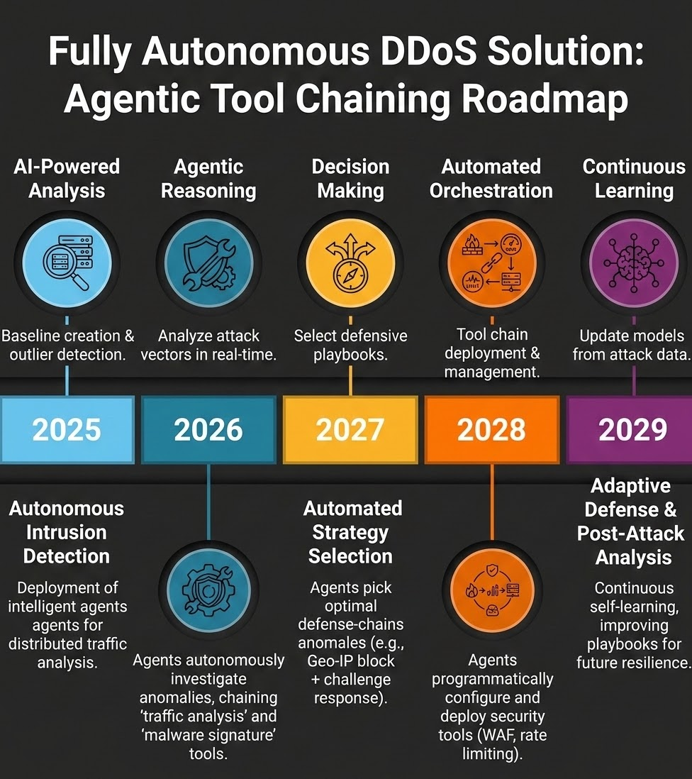
The Path Forward
STRATEGIC VALUE REALIZATION
This journey proves that Network Autonomy is a Sociotechnical challenge. Success requires aligning deep technical requirements with high-level business goals.
The question is not "Can we automate?" but "Can we communicate the value of the automation?"

Slide 16
Key Takeaways
WHAT TO REMEMBER WHEN YOU LEAVE THIS ROOM
Autonomy is a Sociotechnical Problem
Technical excellence alone will not get your project funded. You must align engineering capability with executive metrics.
Observability is the Foundation
Without high-fidelity telemetry, autonomous decisions lack the evidence needed to justify action — or earn board approval.
Measure in Business Outcomes
42 min → 38 sec MTTR. $64k saved per event. 95% engineer reallocation. Report these numbers, not packets per second.
The “Digital Intern” Wins Funding
Frame automation as a transparent, supervised assistant — not an all-powerful black box. Transparency secures the budget.
Phase Your Roadmap
Observe → Chain → Agentize → Autonomy. Each phase must prove ROI before the next begins.
Readiness Before Production
Technical and organizational readiness are equally important. If you cannot explain the failure mode, you are not ready.

Slide 17
Questions?

